Slide 1
Wavelengths Psychology Presents
Executive Functioning in Elementary Aged Children
With Sharon Grand, Ph.D.
Wavelengthspychology.com

Slide 2
What is Executive Functioning?
Executive Functioning is essentially the Administrative Assistant in your child’s brain.
It comes from the frontal lobe of the brain, and involves the “hidden” areas, often not discussed, which are just as essential for success as reading, writing, and arithmetic.

Slide 3
Goals for this presentation
Understand the basic areas of executive function and why these skills are so essential for learning and success
Understand what may make these skills better or worse
Attain some basic developmental tools that will assist your child in learning and strengthening executive function.

Slide 4
The “Not so obvious” function checklist
Attention Management
Planning and Organization
Effort and Motivation
Emotional Regulation
Working Memory
Self-Monitoring

Slide 5
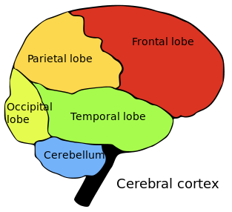
Difficulty being on time
Daydreaming
Having trouble getting started (Lazy)
Giving up easily
Getting bored easily
Being very silly or inappropriate
Arguing or interrupting
Forgetting things
Being disorganized
Not thinking before acting
Hyperfocus and difficulty switching tasks

Slide 6
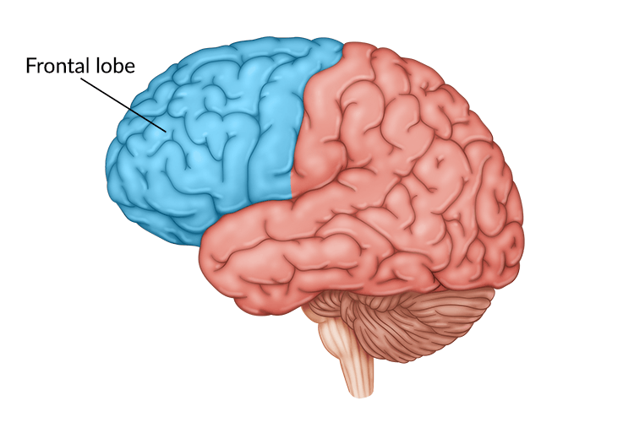

Slide 7
Neuroplasticity
We spend time on different brain paths everyday
With executive function difficulties, we have less control over these roads.
Harder time staying on boring ones, such as paying attention in lass, doing homework, or sitting still
More easily distracted over to interesting ones
This is no one’s fault!

Slide 8
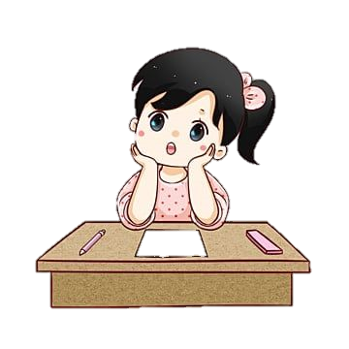
Why does this happen?
Genetics
Development
Other medical conditions
Anxiety, overwhelm, or chronic stress
Life changes
Trauma

Slide 9
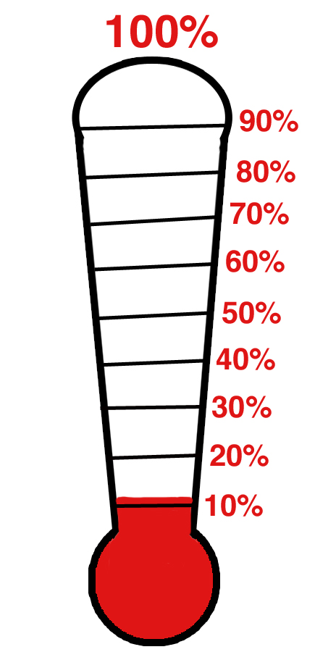
Attention Management
90%
Stress ball
60%
Extra help
30%
Sit Closer
5%
Boring!

Slide 10
Planning and Organization
Organization involves how we gather stimuli in our environment to complete tasks quickly and more effectively. It’s how we arrange our environment and provide order and structure to the items and activities around us. Organization skills are often closely tied to our ability to plan and prioritize

Slide 11
Planning and Organization Skills
Order items or pictures into sequential order.
Tell an organized story with a beginning, middle, and end.
Returns items back to where they belong
Clean up at the end of an activity or the end of the day.
Maintains toys, personal items, and workspace in a neat and orderly manner.
Arrive at school or work with the required materials.
Keep personal items in good condition.
Develop an outline or list to organize tasks and topics systematically.
Arriving on time and prepared

Slide 12
Effort/Motivation

Slide 13
Emotional Regulation
Executive function difficulties are related to decreased activity in the part of the brain responsible for filtering emotions.
Difficulty thinking before acting
May be “ruled” by emotions
Notes:
Little things have the potential to annoy us all day long. We forget something at home that we need or someone asks us to do something that we don’t feel like doing. Hopefully we have the capacity to pause or just shrug it off. For larger issues we can reflect for a moment and then choose a healthy response instead of losing control. When children have executive function difficulties they have decreased activity in the part of the brain that is responsible for filtering emotions, and that can result in them reacting on a hair trigger. Basically, they are not able to think before they act, and they may be ruled by their emotions. Emotional dysregulation may involve intense mood swings set up by frustrations and challenges It may mean that each and every time something rattles them they lash out one moment they may be happy the next moment they might explode with anger and it’s hard to know what the trigger is

Slide 14
Working memory
The brain’s ability to keep track of information before storing it
We hold things in working memory first, deciding what is important, categorizing information as either necessary or disposable, and then storing it.
We use working memory also to retrieve information from long term storage. For instance, if a child wants to tell you about what he learned about sharks, he needs coordinated access to the information in his brain to mentally arrange it and paraphrase it to communicate this to you.

Slide 15
Working Memory affects:
Working memory affects:
Day-to-day learning and productivity.
Reading Comprehension
Narrative writing
Mental “to do” lists
Remembering where you put something down, phone messages, etc

Slide 16
Self Monitoring
Awareness of and self-correction of moment-to-moment behavior

Slide 17
Attention Management
At School:
Take a deep breath
Get a drink of water
Sit close to the teacher
Keep a Koosh ball or stress ball with you to squeeze or pull
Sit up straight
Doodle
Eat a power food snack – protein
Chew gum or have a mint if your teacher will let you

Slide 18
Attention Management at Home
At Home – for homework:
Try a mint or sour candy (this is good for homework – try using 3-5 candies per night while you work – not too much!) or chew gum
Keep the TV OFF
Stay away from any cell phones or video games – they are distractors
If your siblings or parents are distracting you – let them know.
Do your homework in the same place every day.
Other Activities:
Get enough sleep
Eat power foods – protein is great – nuts, cheese, meat. Stay hydrated. Breathe deeply.
Practice mindfulness
Do one thing at a time
Use a timer

Slide 19
Organizational strategies
Routine, routine, routine
Keep a visual calendar as early as possible.
Clean out backpacks every day (with parent observation)
Review homework planner every day
Have “pockets” of organization
Practice putting away complicated items by color, shape, or size
Learn time early and work on time strategies
Lists and labels
Visuals – color coordination, top cubby, etc

Slide 20
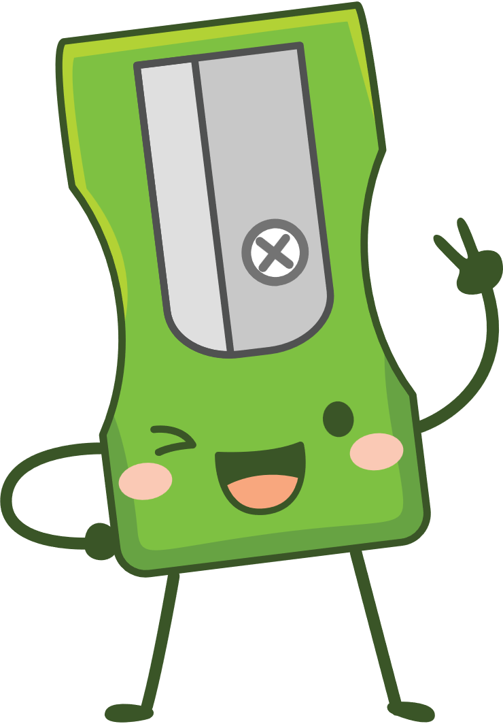
Effort and Motivation
Timing and situation
Try changing the timing of a task
Try to avoid moving from high interest tasks to low interest tasks
Break tasks down into one or two step instructions at a time

Slide 21
Effort and Motivation
Reward systems
Timers
Parent Support
Short and simple
Goals
Notes:
Note that kids with executive function difficulties may do great as long as support and rewards are in place, but once removed they will often downslide immediately.
They may need rewards and support much longer that other kids, even into high school. Even very bright kids with executive dysfunction may need to use timers for homework, have a parent help them figure out homework, or help them keep their homework area clean, and other organizational tasks. Frontal lobes develop until age 25, so many colleges offer executive function coaching for college students as well!

Slide 22
Working memory
Routine!
Lists are very helpful – morning and evening, backpack, etc
Zipper binders
Think about where to write homework
Teach them to use phone calendars with alerts
Leave things in obvious places, gone is forgotten
Keep instructions more minimal if needed
Play memory and card games
Let your child teach you
Read aloud and ask questions
Avoid distractions

Slide 23
Emotional Dysregulation
Reward systems to increase motivation are useful, but they must gauge what the child is capable of.
Finding a way to slow down or take a break
Mindfulness teaches the brain to slow down
Time outs to teach child self control
Take a break cards
Knowing what some of the triggers are and providing reminders
Exercise and sleep are critical
Yoga, martial arts
Child goes up, parent goes down

Slide 24
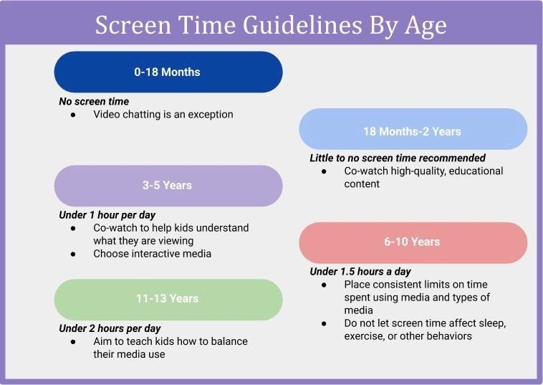
Screen time and Boredom
Notes:
Too much time spent in front of a screen and multitasking with other media has been related to worse executive functioning and academic performance. As screen time reduces the amount and quality of interactions between children and their caregivers, it can also have an impact on language development. Additionally, excessive screen usage has detrimental effects on social and emotional growth, including a rise in the likelihood of obesity, sleep disorders, and mental health conditions including depression and anxiety. It can obstruct the ability to interpret emotions and fuel aggressive conduct, (screens don’t care how the child reacts)

Slide 25
How to limit screen time
Use screens as a reward
Remove non-essential screens during homework, and monitor
Remove screens during family time, meal times, and in the car
Keep kids involved in activities and on playdates
Create home activities for them to do
The Imagination Tree Mommy Poppins School based activities Crafts/sports

Slide 26
Professional Interventions
Evaluations – What is causing this?
Parent support and education – what is happening for my child and how can I help in a way that is doable for our family?
Cognitive Behavioral Therapy
Mindfulness
Play Therapy
Medication
Neurofeedback

Slide 27
Apps
Attention Management: Bear focus timer, Forest,
Planning and Organization: Apple Calendar, Busy Kid
Effort and Motivation: Finch, Streaks
Emotional Regulation: Smiling mind, Mindful powers
Working Memory: Memory games, matching, elevate
Self-Monitoring: Iconnect

